Slide 1
COMP 3500 Introduction to Operating Systems Paging:
1. Hierarchical Page Tables
2. Translation Look-aside Buffers (TLB)
Dr. Xiao Qin
Auburn University http://www.eng.auburn.edu/~xqin
xqin@auburn.edu
Notes:
Fall’17
All slides were covered except slides 13 LRU and 17 TLB algorithm.
No time to collect Plicker answers for exercise 6.1-6.4. (Review it in the next lecture!)
Spring’17 50 Minutes: slides 1-13
Ex1-5.
No time for Exercise 6 of 13b-Paging TLB-Handout

Slide 2
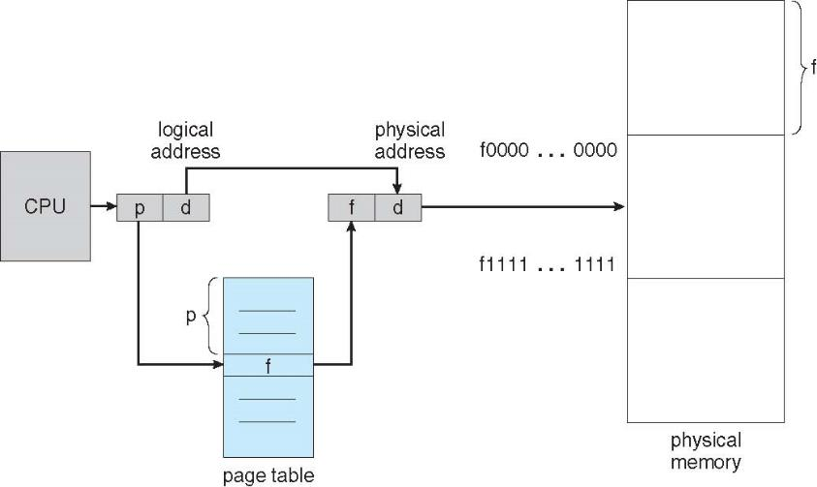
Review: Logical-to-Physical Address Translations

Slide 3
Two registers to support paging
Where should we keep page tables?
Where does the Page-table base register (PTBR) point at?
The Page-table length register (PTLR) indicates size of the page table.
Notes:
Main memory
Table table.

Slide 4
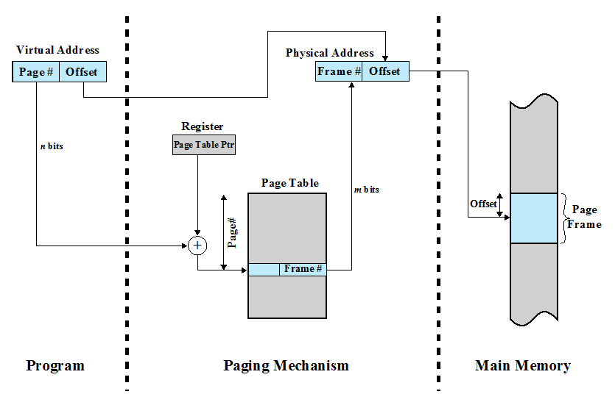
Page-table Base Register (Page Table Pointer)
Exercise 1 (Plickers): How many memory accesses are there a word is accessed from the physical memory ?
A. 0 B. 1 C. 2 D. 3

Slide 5
Hierarchical Page Tables
Break up the logical address space into multiple page tables
A simple technique is a two-level page table
We then page the page table

Slide 6
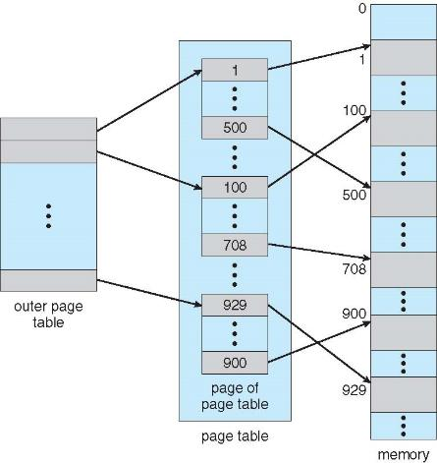
Two-Level Page-Table Scheme

Slide 7
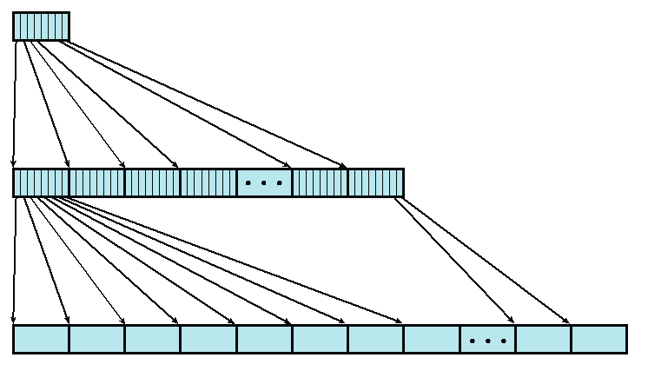
Exercise 2 (Plickers): Two-Level Page Table
2.1. How many root page table entries?
A. 512; B. 1024; C. 2048; D. 4096
4KB root page table
Assumption
we have 4-byte page table entry.
page size is 4KB
User Page Table
2.2. How many user page table entries?
1K; B. 512K;
C. 1M; D. 4M
2.3. How large is the user address space?
A. 512MB; B. 1GB; C. 2GB; D. 4GB
Notes:
An example of a two-level scheme typical for use with a
32-bit address. If we assume byte-level addressing and 4-kbyte (2 ¹² ) pages, then the
4-Gbyte (2 ³² ) virtual address space is composed of 2 ²⁰ pages. If each of these pages
is mapped by a 4-byte page table entry, we can create a user page table composed of
2 ²⁰ PTEs requiring 4 Mbytes (2 ²² ). This huge user page table, occupying 2 ¹⁰ pages,
can be kept in virtual memory and mapped by a root page table with 2 ¹⁰ PTEs occupying
4 Kbyte (2 ¹² ) of main memory.

Slide 8
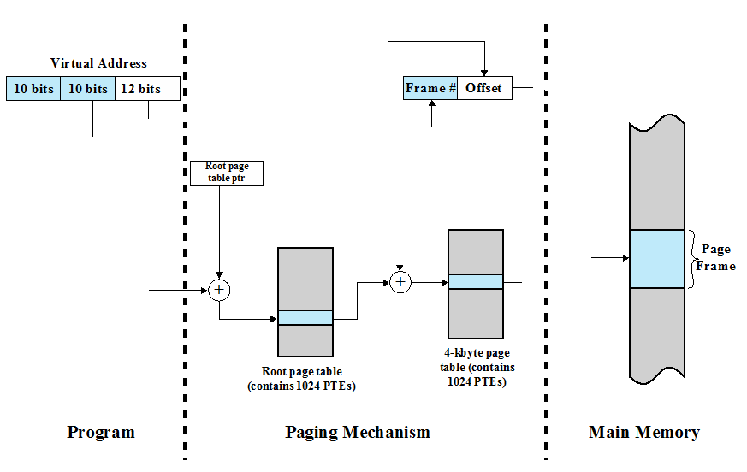
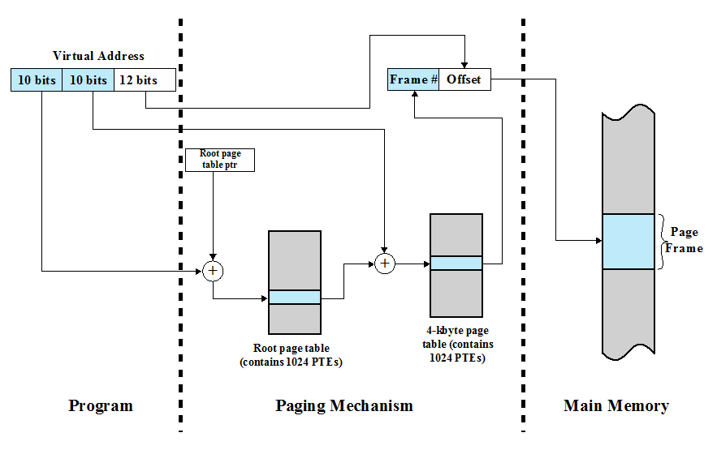
Exercise 3: Address Translation in the Two-Level Paging System

Slide 9
Exercise 4 (Plickers): Design virtual address format for a two-level paging system
Suppose you design a two-level page translation scheme where page size is 16MB and page table entry size is 16 bytes.
What is the format of a 64-bit virtual address?
A. | 20 bits | 20 bits | 24 bits |
B. | 20 bits | 24 bits | 20 bits |
C. | 24 bits | 20 bits | 20 bits |
D. | 16 bits | 24 bits | 24 bits |

Slide 10
Exercise 5 (Wheeldecide): Memory Accesses in the Paging Scheme
To load an instruction or data from main memory, how many memory accesses are required in the paging scheme?
two memory accesses
One for the page table and one for the data / instruction
How can you reduce the number of memory access?
The two memory access problem can be solved by the use of a special fast-lookup hardware cache called associative memory or translation look-aside buffers (TLBs)

Slide 11
COMP 3500 Introduction to Operating Systems Paging: Translation Look-aside Buffers (TLB)
Dr. Xiao Qin
Auburn University http://www.eng.auburn.edu/~xqin
xqin@auburn.edu

Slide 12
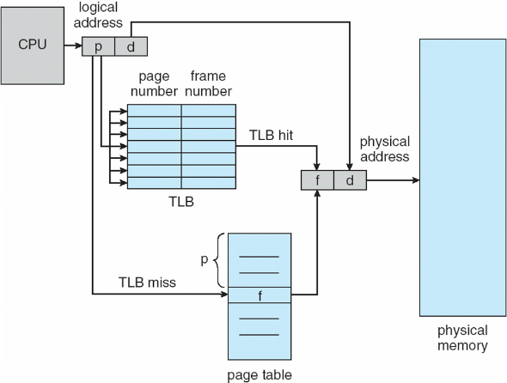
Paging Hardware with Translation Look-aside Buffers (TLB)
Why TLBs are typically small (64 to 1,024 entries)?

Slide 13
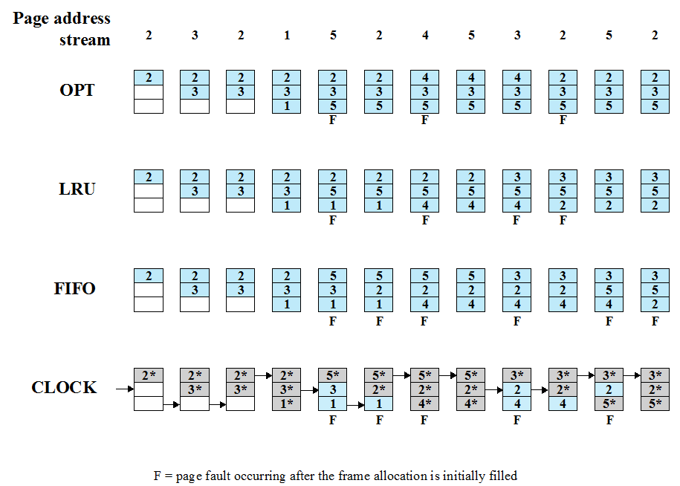
Notes:
The optimal policy selects for replacement that page for which the time to the next
reference is the longest. It can be shown that this policy results in the fewest number of
page faults [BELA66]. Clearly, this policy is impossible to implement, because it would
require the operating system to have perfect knowledge of future events. However, it
does serve as a standard against which to judge real-world algorithms.
Figure 8.14 gives an example of the optimal policy. The example assumes a
fixed frame allocation (fixed resident set size) for this process of three frames. The
execution of the process requires reference to five distinct pages. The page address
stream formed by executing the program is
2 3 2 1 5 2 4 5 3 2 5 2
which means that the first page referenced is 2, the second page referenced is 3, and
so on. The optimal policy produces three page faults after the frame allocation has
been filled.

Slide 14
Parallel Searching the TLB
How to search TLB?
Associative memory: parallel search
Address translation (p, d)
If p is in associative register, get frame # out
Otherwise get frame # from page table in memory

Slide 15
Address Space ID in TLBs
Question: Why some TLBs store address-space identifiers (ASIDs) in each TLB entry – uniquely identifies each process?
To provide address-space protection for that process

Slide 16
Question: What happens on a TLB miss?
Value (?) is loaded into the TLB for faster access next time
Replacement policies must
be considered
Notes:
What value? (page#, frame#) in the page table.
Replacement policies must be considered
Some entries can be wired down for permanent fast access

Slide 17
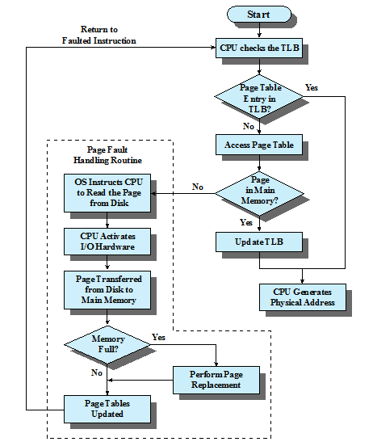
Paging and Translation Lookaside Buffer (TLB)

Slide 18
Effective Memory Access Time
Associative Lookup = Ttlb time unit
TLB hit ratio = h
percentage of times that a page number is found in the associative registers;
T_{hit} = T_{tlb} + T_{mem}
T_{miss} = T_{tlb} + T_{mem} + T_{tlb_update} + T_{mem}
access page table
access data
T_{miss} = T_{tlb} + T_{mem} + T_{mem}
Effective Access Time = h*T_{hit} + (1-h)*T_{miss}
Notes:
TLB update and accessing data in memory are performed in parallel
T_tlb_update << T_mem
Associative Lookup = Ttlb time unit
Can be < 10% of memory access time
Hit ratio = h
Hit ratio – percentage of times that a page number is found in the associative registers; ratio related to number of associative registers

Slide 19
Exercise 6 (Plickers): Effective Access Time
Consider a single-level paging scheme. The TLB has 32 entries. The TLB access time is 10 ns; memory access time is 200ns.
How long does it take to access data in memory if there is a TLB hit?
How long does it take to access data in memory if there is a TLB miss?
What is the effective memory-access time if we have a TLB hit ratio of 80%?
What is the minimal hit ratio that guarantees the effective access time of at most 220ns?

Slide 20
Exercise 6.1 (Plickers): Effective Access Time
Consider a single-level paging scheme. The TLB has 32 entries. The TLB access time is 10 ns; memory access time is 200ns.
How long does it take to access data in memory if there is a TLB hit?
A. 10 ns
B. 200 ns
C. 210 ns
D. 410 ns

Slide 21
Exercise 6.2 (Plickers): Effective Access Time
Consider a single-level paging scheme. The TLB has 32 entries. The TLB access time is 10 ns; memory access time is 200ns.
How long does it take to access data in memory if there is a TLB miss?
A. 200 ns
B. 210 ns
C. 400 ns
D. 410 ns

Slide 22
Exercise 6.3 (Plickers): Effective Access Time
Consider a single-level paging scheme. The TLB has 32 entries. The TLB access time is 10 ns; memory access time is 200ns.
What is the effective memory-access time if we have a TLB hit ratio of 80%?
A. 210 ns
B. 250 ns
C. 370 ns
D. 410 ns

Slide 23
Exercise 6.4 (Plickers): Effective Access Time
Consider a single-level paging scheme. The TLB has 32 entries. The TLB access time is 10 ns; memory access time is 200ns.
What is the minimal hit ratio that guarantees the effective access time of at most 220ns?
A. 85%
B. 90%
C. 95%
D. 98%

Slide 24
Summary
Page-table Base Register
Two-Level Page Table
Address Translation in a Two-Level Paying System
Translation Look-aside Buffers (TLBs)
Effective Memory Access Time

